Slide 1
Career Lessons Learnt
Ujwani Nukala, MS
03-28-2019
MCBIOS 2019

Slide 2
?
What is the first thing you need to have
before starting your job search

Slide 3
Professional Network
What is the first thing you need to have
before starting your job search

Slide 4

Professional Network
Join Professional Organizations
Attend Meetings
Join College Alumni Club
Ask for Help or Advice
Use Social Media – LinkedIn and Twitter

Slide 5
Social Media
44% of employers have found content that caused them to hire the candidate.
57% are less likely to interview a candidate they can’t find online.
54% have decided not to hire a candidate based on their social media profiles.
AAPS Career Development

Slide 6
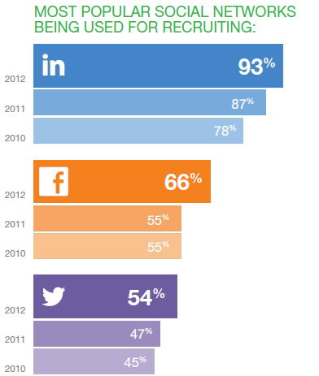
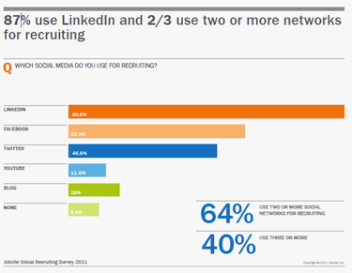
Why LinkedIn
https://www.cnet.com/news/heads-up-linkedin-users-93-of-recruiters-are-looking-at-you/
https://www.smartrecruiters.com/blog/5-social-recruiting-alternatives-to-facebook/

Slide 7
Linkedin MISTAKES
You don’t have a profile picture or its not a good one
You have a generic and boring headline
You have very few connections
You have not used the right keywords
You profile isn’t public
You have not updated your profile for a long time

Slide 8
Linkedin DO’s
Network - 500+ connections
Professional profile picture
Send customized invitations to connect
Ask for referral
Include key words
Summary should be results oriented – Include numbers when possible.

Slide 9
Second important thing is your
RESUME

Slide 10
RESUME facts
6.25 seconds first glance
ATS is used by ~ 75% companies, a specialized database which evaluates resumes against open job postings and conclude that they do not match!!!
Stick to plain text
No borders or fancy designs
Optimize resume using keywords

Slide 11
RESUME facts
Strong leadership skills and experience managing research professionals on collaborative projects resulting in 10 publications and $ 100,000 in research grant funding.

Slide 12
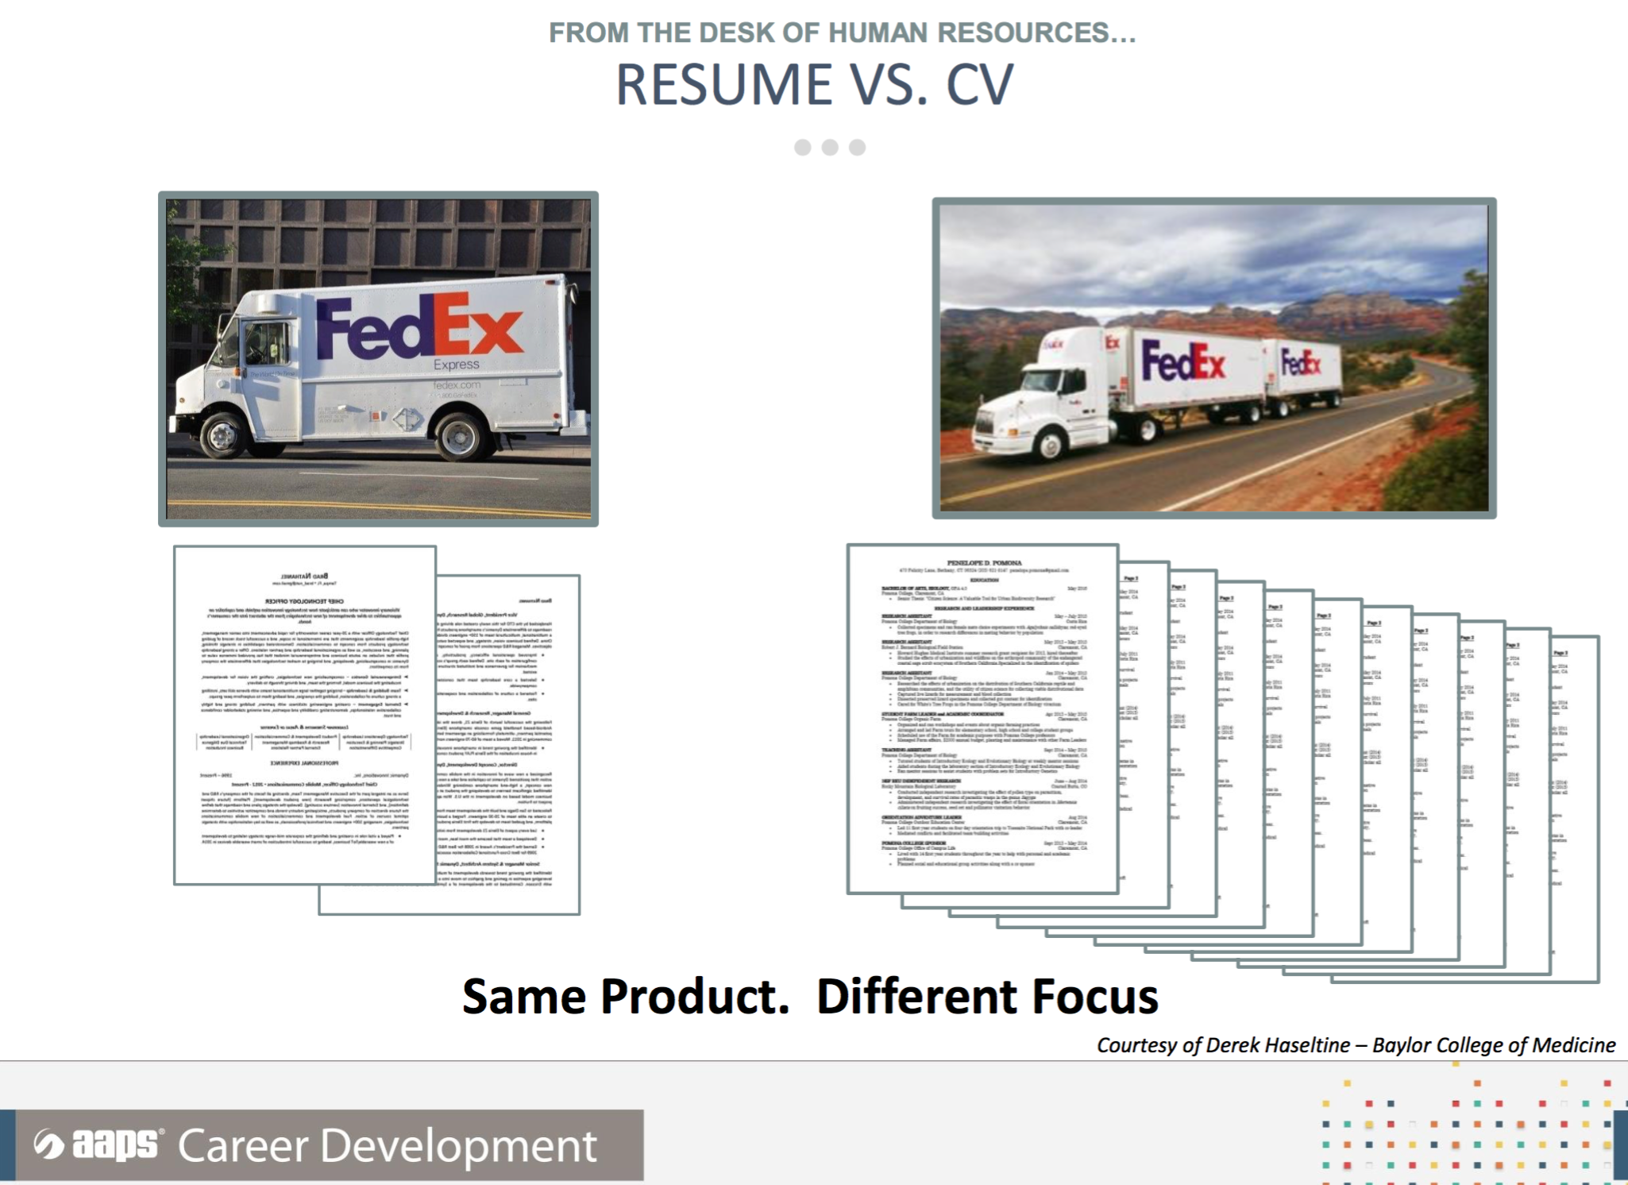
Difference between resume and Cv
Notes:
Resumes are typically used when applying for non-academic positions and are usually 1 page. They are tailored for a specific job. Eg :… They include education, experience and skills
CV are used for academic positions and are longer than resumes. They include papers, projects, grants all your accomplishments etc.

Slide 13
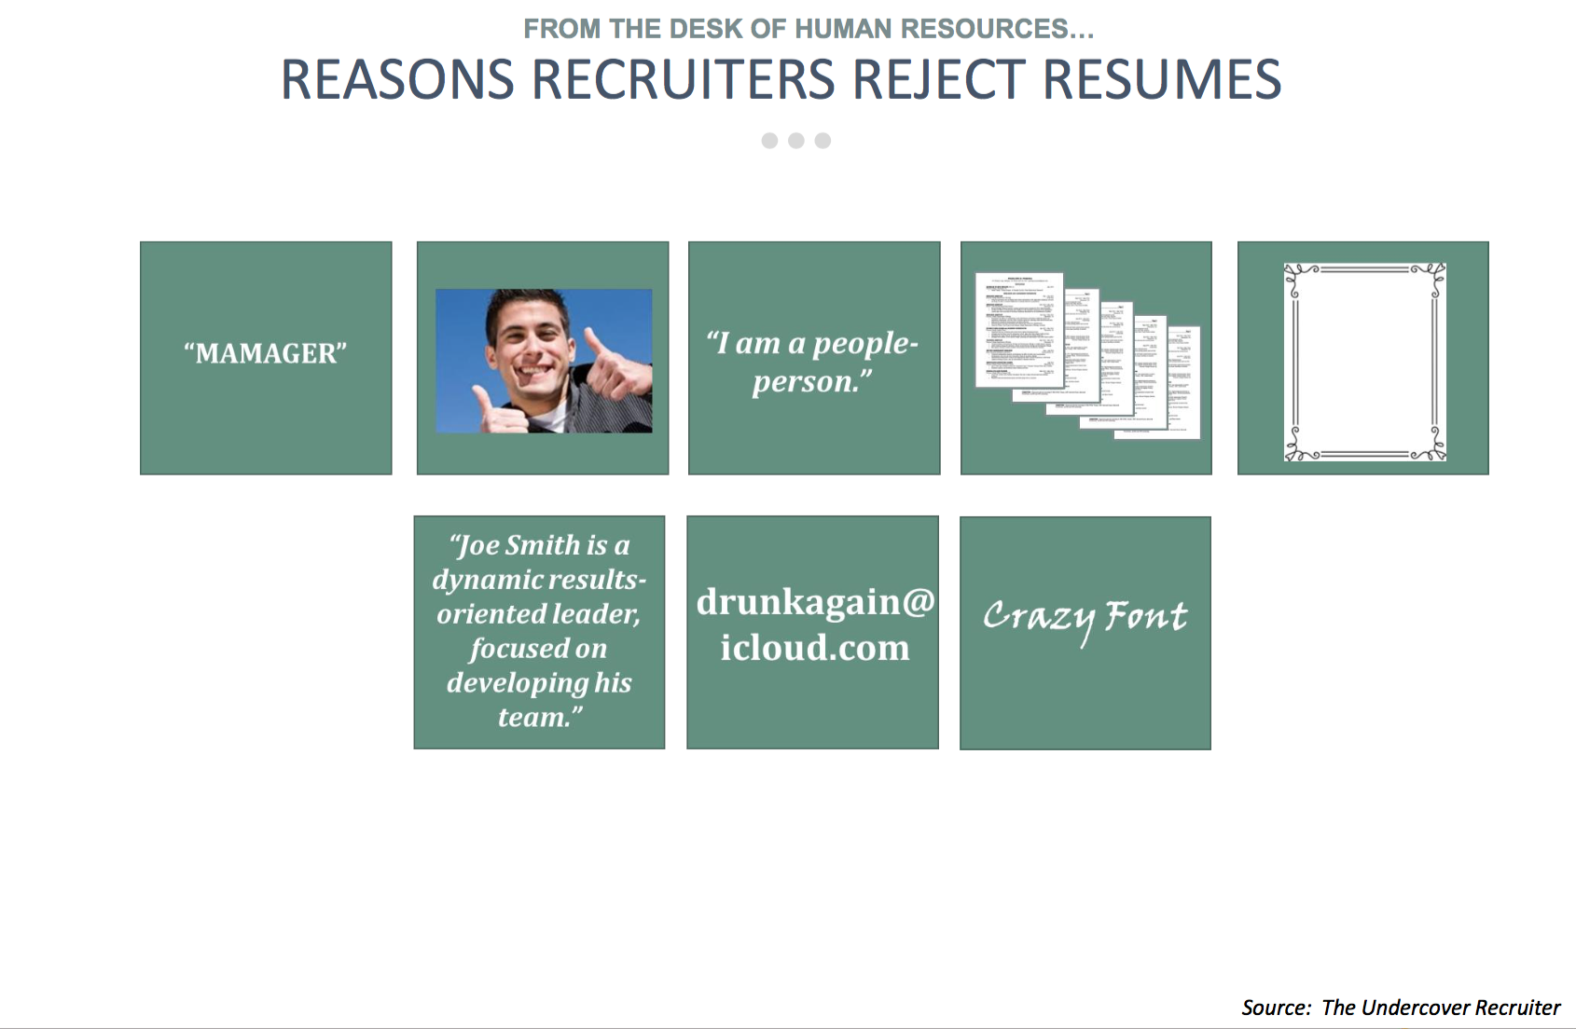
AAPS Career Development

Slide 14
SUMMARY

Slide 15
Think like a recruiter
network
Customized resume
Key words
Cover letter
Notes:
Cover letter – gap in the resume, relocation, explain how can you be a good fit and show your interest in joing their company etc

Slide 16
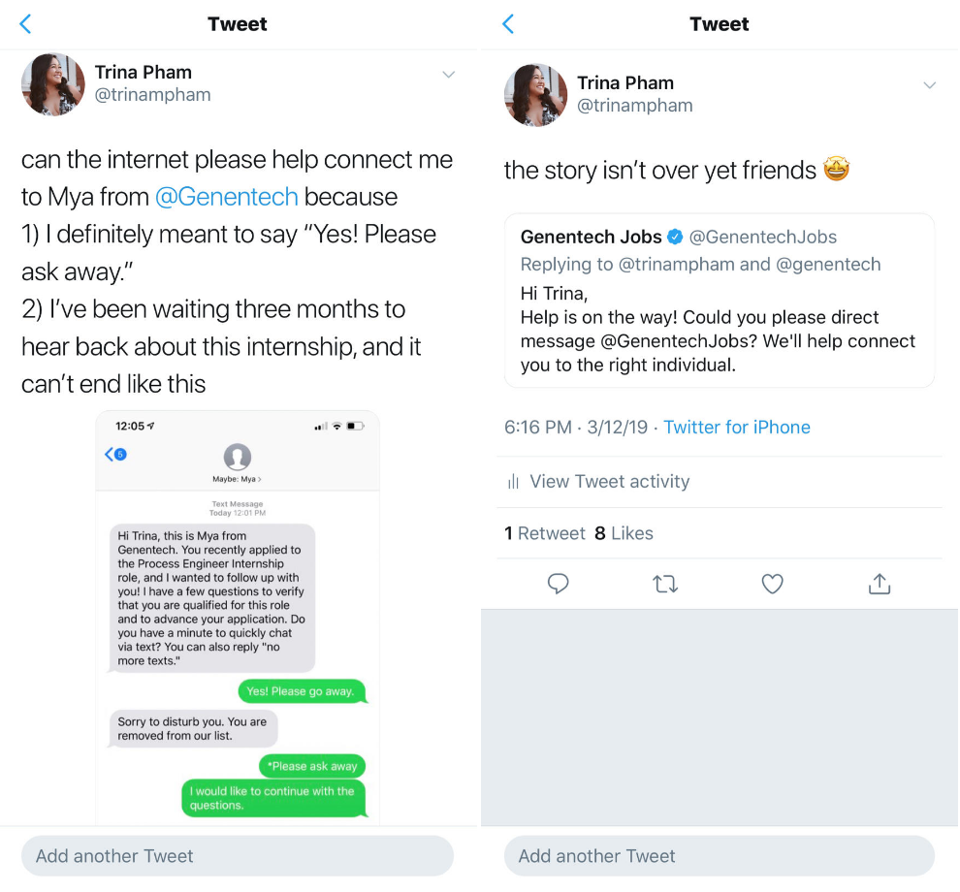
Leverage your resources

Slide 17
Resources
https://theundercoverrecruiter.com/
www.Scientificresumes.com
http://career.uark.edu/cdc/students/resume/
Publications - Chen B. Ten simple rules for internship in a pharmaceutical company.
AAPS Career Development Webpage
https://jobstars.com/job-seeker-resources-list/

Slide 18
Thank you

